Slide 1
Estimating Epidemic Severity Rates
Jeremy Goldwasser

Slide 2
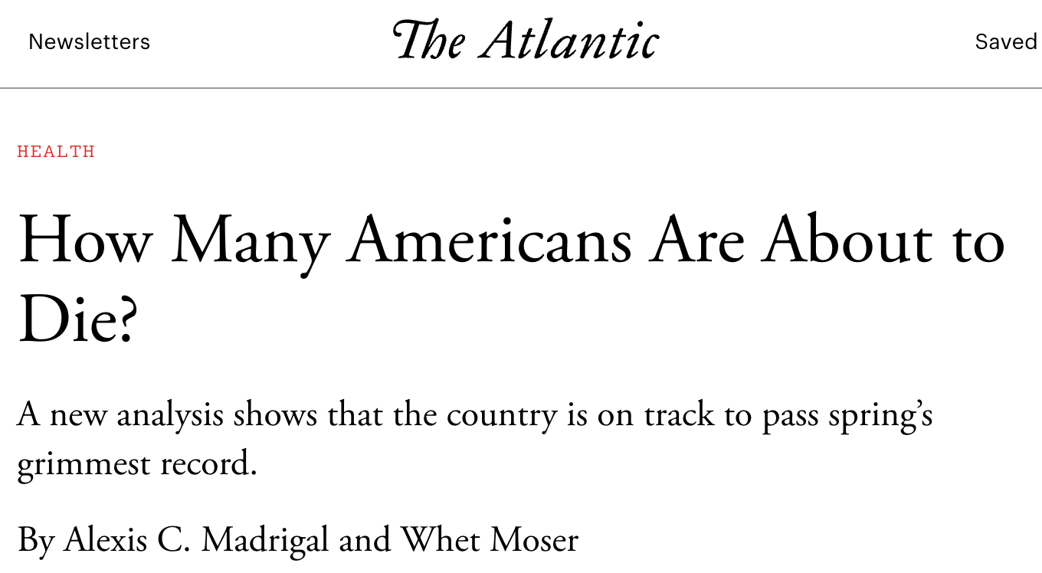
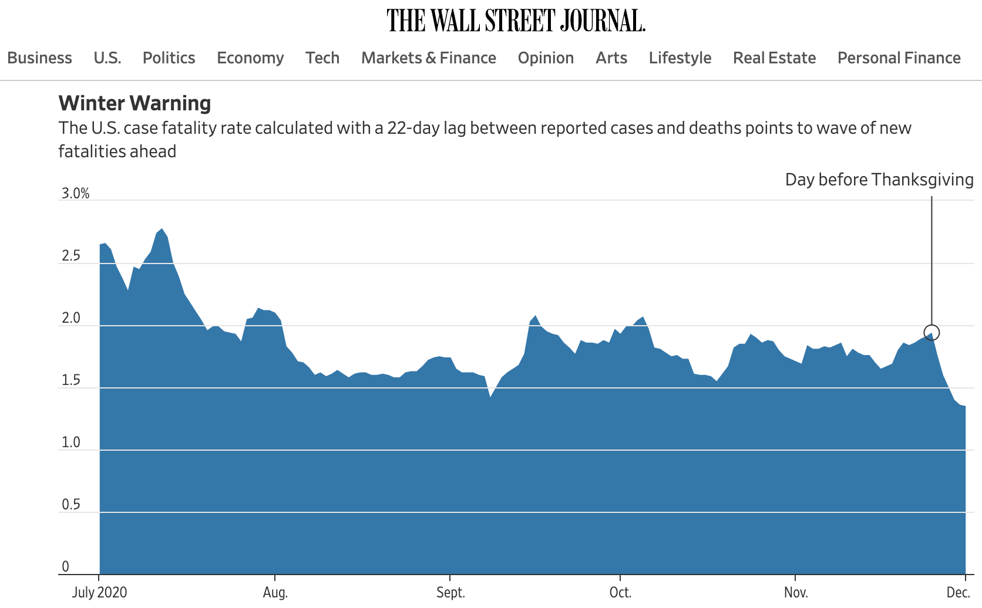
Time-varying severity rates in epidemiology
Severity rates express the probability that a primary event at time t will result in serious secondary event, e.g.
Case-fatality rate (CFR)
Hospitalization-fatality rate (HFR)
Time-varying or stationary?
Most academic work on estimating severity rates assumes stationarity over time.
Severity rates constantly change due to new variants, therapeutics, etc.
Epidemiologists at the CDC use time-varying rates to analyze new risks.
Notes:
150k forecasted cases/day, 1.5% CFR, >2k deaths/day

Slide 3
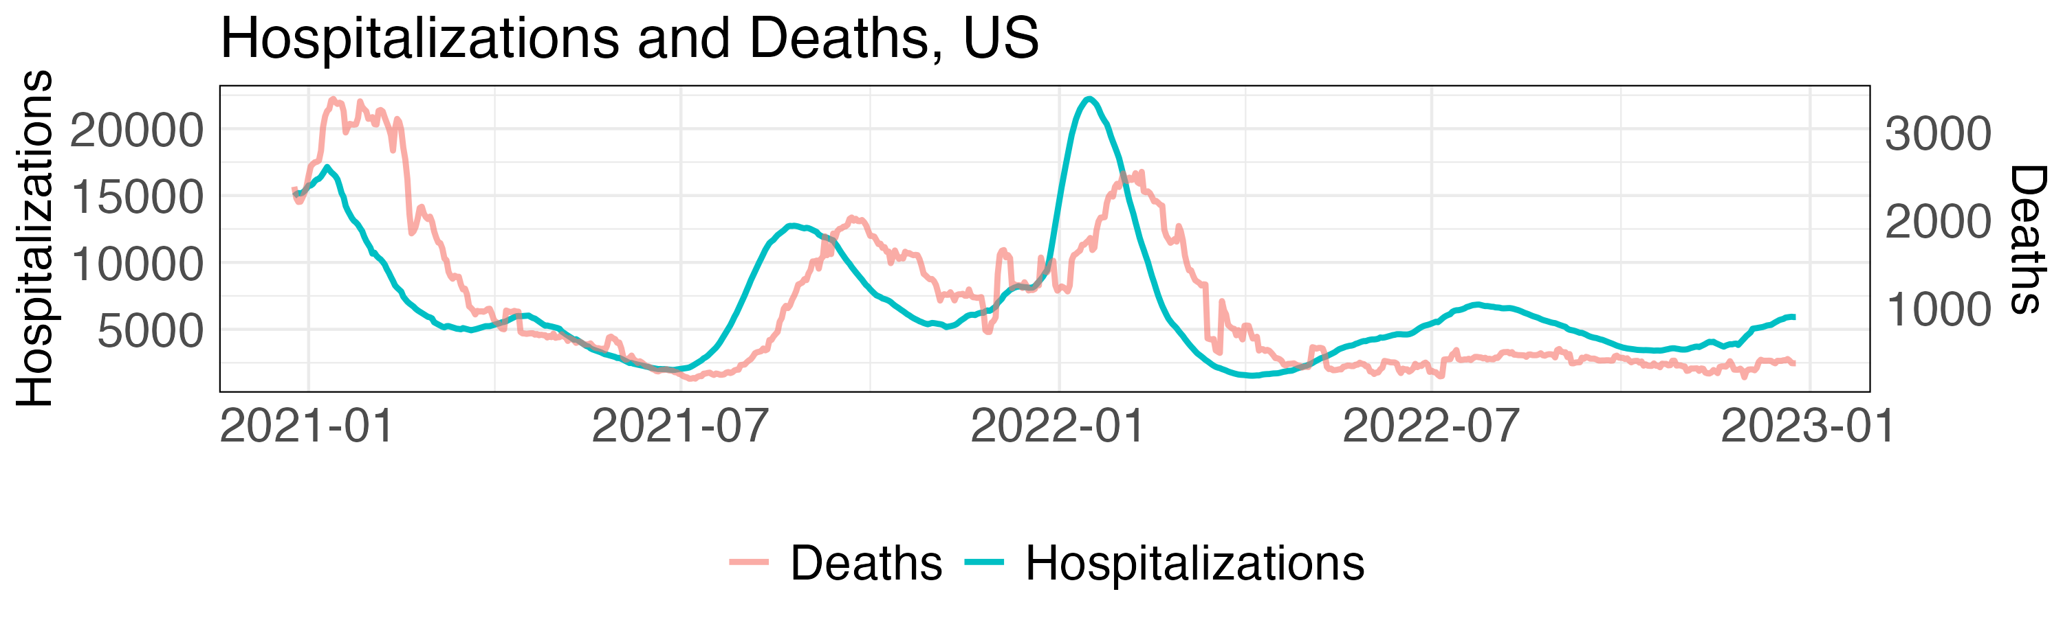
Often estimate severity from aggregate data
Calculating severity rates is straightforward with a line list of patient outcomes.
CFR: Observe fraction of patients that tested positive at t who ultimately die.
Maintaining such a line list may be unrealistic or impossible
In this case, severity rates must be estimated from aggregate count data.
Notes:
Give numbers for X counts, Y counts, completeness of linelist

Slide 4
Standard ratio estimators
Most estimators for severity rates are simple ratios (“case fatality ratio”) between secondary events and at-risk primary events
The standard time-varying approach is a lagged ratio of aggregate counts:
A more principled generalization uses the delay distribution:
Our work: Understanding the bias of these ratios and proposing statistically sound alternatives.
Notes:
Note estimate of the delay distribution can be used. Obtain from line list, or from aggregate. Typically fit parametric model, not so hard.

Slide 5
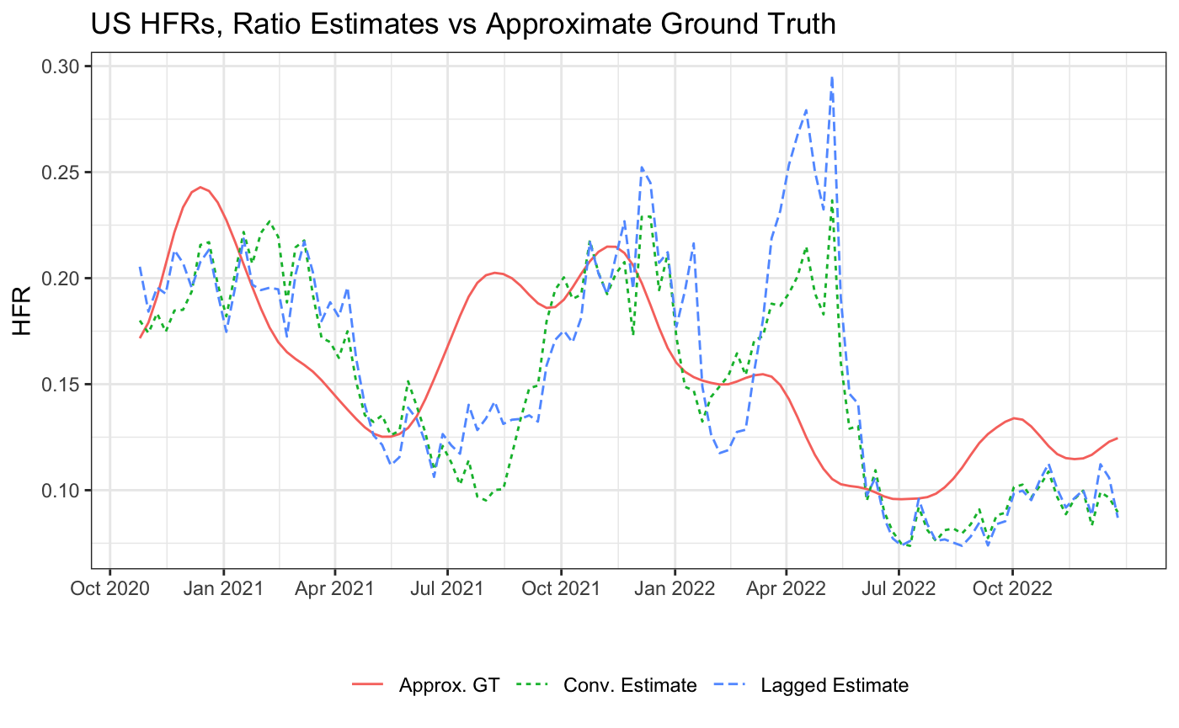
Observed these ratios exhibit huge bias
Notable failures, HFR:
Signaled enormous, nonexistent surge after Omicron peak – especially lagged ratio.
Ignored higher risk as Delta took over
Findings robust across parameters, geography, etc.
Notes:
Mention A) “ground truth” only a proxy, and B) lagged in new reports, twitter threads etc

Slide 6
Proposed solution: model the relationship between series
Let Y_{t}|X_{s≤t} denote e.g. the number of deaths at time t given prior hospitalizations.
We identify this adheres to a Poisson Binomial distribution – a generalization of the binomial distribution where not all success probabilities are equal.
While its PMF is intractable, it is well-approximated by a Gaussian with mean
and variance
Notes:
Point-wise true

Slide 7
Proposed solution: approximate MLE of probabilistic model
Correlation is negligible
Normal approximation at all t
Ignore variance term
Plug-in variance
Plug-in delay distribution

Slide 8
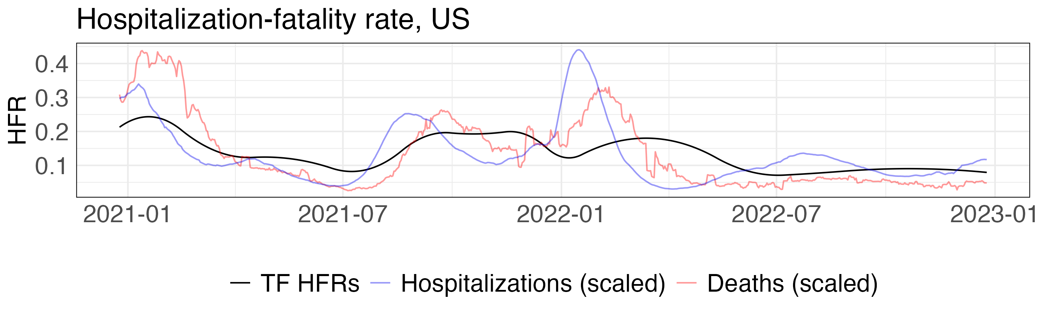
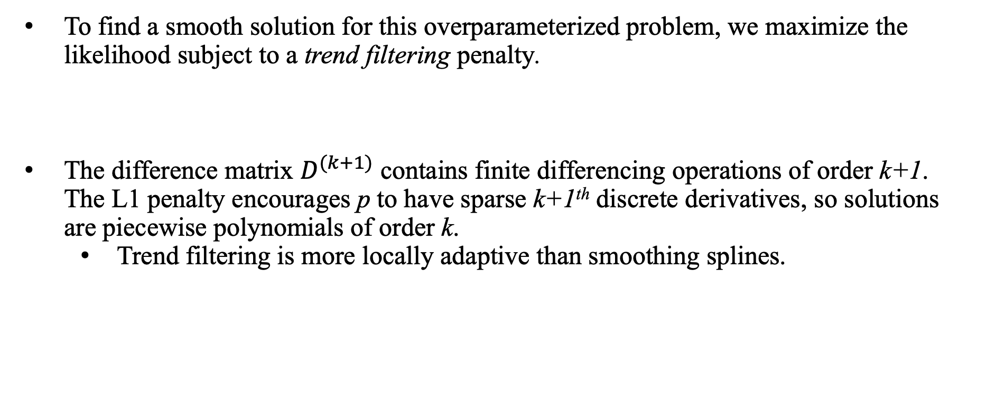
Proposed solution: learn severity rates with smoothed MLE
To find a smooth solution for this overparameterized problem, we maximize the likelihood subject to a trend filtering penalty.
The difference matrix $D^{(k+1)}$ contains finite differencing operations of order k+1. The L1 penalty encourages p to have sparse k+1th discrete derivatives, so solutions are piecewise polynomials of order k.
Trend filtering is more locally adaptive than smoothing splines.
Notes:
Slide explaining / example of D^(k+1)? Also, should have a figure comparing TF versus the lagged method!

Slide 9
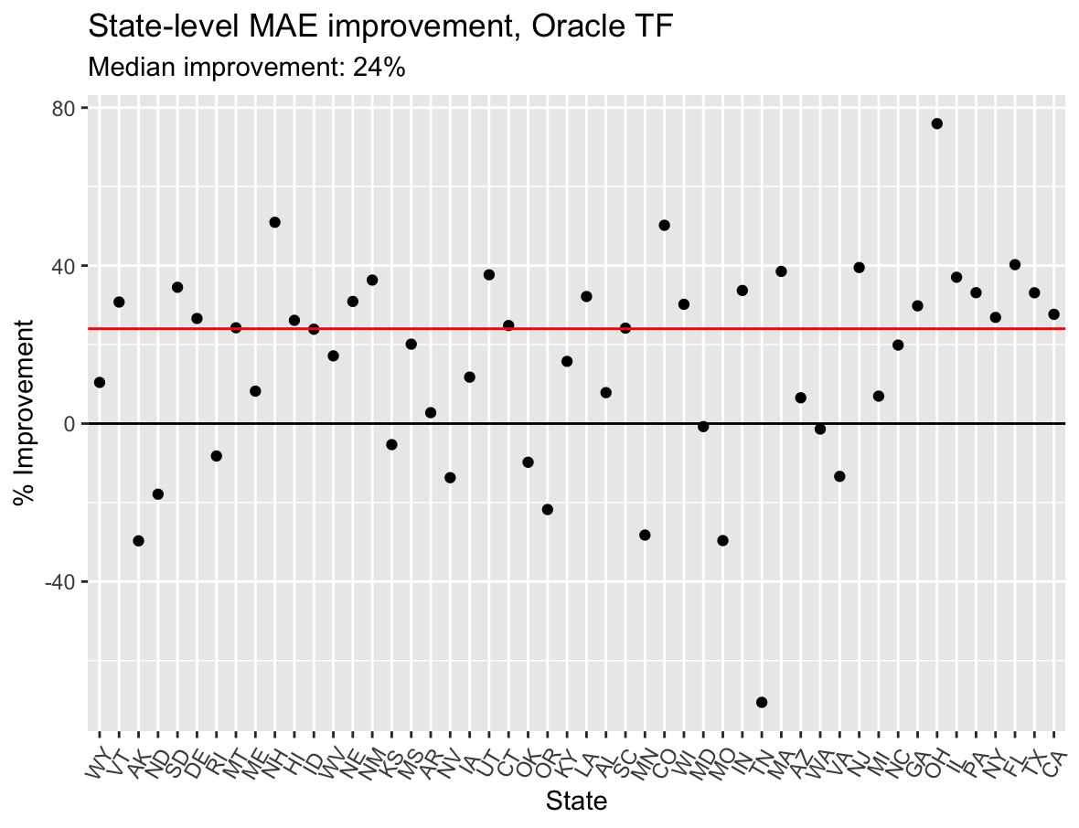
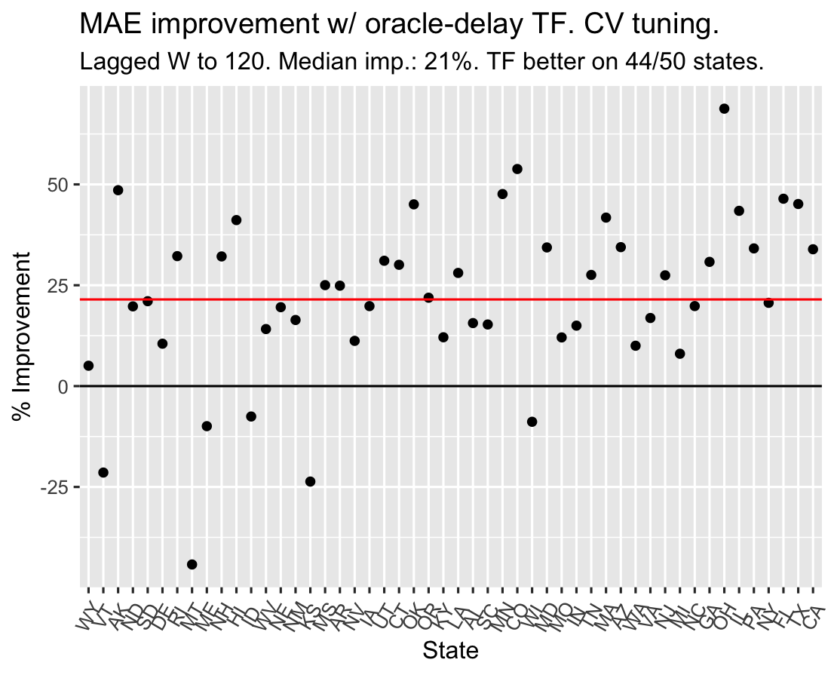
Trend filtering estimator outperforms lagged estimator
State-level deaths simulated from overdispersed probabilistic model.
On average, trend filtering lowers MAE by >20% over the lagged estimator – with both cross validation and oracle tuning.
Notes:
From 2/6/24 and 4/26/24 or so. Explain what these plots mean! Also, mention we still need to compare to convolutional ratio!!

Slide 10
Ongoing: Adapt trend filtering for real-time setting
Requires extra regularization to mitigate tail variability, since most recent severity rates used for fewer observed predictions.
Jahja et al. (2022) used natural trend filtering & tapered smoothing for similar deconvolution problem.
Also aim to quantify uncertainty of severity estimates and compare to convolutional ratio.
x_{t-2}
x_{t-1}
x_{t}
p_{t-2}
p_{t-1}
p_{t}
y_{t-2}
y_{t-1}
y_{t}
y_{t+1}
y_{t+2}
Notes:
More TO DOs: Compare to convolutional ratio; uncertainty quantification

Slide 11




Collaborators

Slide 12

Thanks for your attention!

